Slide 1
Intermediary organisation engagement - How to support smaller employers to access the apprenticeship service
@ESFAdigital
Notes:
Hello and welcome to this video about how intermediary organisations can help to support smaller employers to access the apprenticeship service.
I would like to spend the next few minutes talking to you about how we will be working with you to support your members and employers with the transition onto the apprenticeship service.

Slide 2
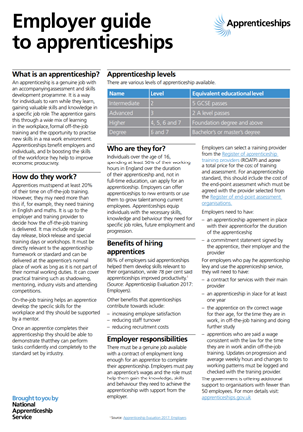
Business Engagement
EMPLOYER RELATIONS
Communications through campaigns, social media and business updates we lead delivery of major strategic communications activities for apprenticeships and T Levels
Partnerships with over 500 intermediaries, membership and sector bodies.
High profile strategic networks of senior business leaders like the Apprenticeship Ambassadors Network (AAN) the Intermediary Ambassador Network (IAN) and the Apprenticeship Diversity Champions Network (ADCN).
Support for businesses of all sizes via the free National Apprenticeship Service helpline. This provides free, impartial advice on recruitment, choosing the right framework or standard, finding the right training provider and advertising vacancies. Expanded to support employers wanting to offer Industry Placements We also provide support on using the GOV.UK apprenticeship service to help employers utilise the digital tools that enable them to manage their apprenticeships.
Account management - relationships with over the largest levy payers. These employers make the greatest investment in apprenticeships and therefore receive bespoke support from an account manager.
Notes:
The National Apprenticeship Service provides free, impartial, expert skills advice and support to employers of all sizes, in every sector throughout England.
The service covers all aspects of the skills offer including apprenticeships, traineeships and industry placements, persuading and assisting businesses looking to recruit for the first time and / or to develop their existing workforce.
Four services are offered to businesses. They reach different types of employers from small to medium sized non levy to the largest levy payers:
Communications
Partnerships
Support
Account Management
There are around 5.2 million businesses in the UK and over 99% of those are SMEs. About 1.2m of these businesses employ somebody.
Recent research from the Federation of Small Business confirms that there is significant appetite among smaller employers to engage with apprenticeships: one in four of their members currently has at least one apprentice, with a further 24 per cent thinking about employing one in the future.
There is room for improvement on making information about apprenticeships more accessible and visible to smaller businesses. The Apprenticeships Evaluation found that businesses with fewer than 10 employees were less likely than others to feel that the information, support and guidance available when making decisions on offering apprenticeships was sufficient (63% compared with 71%) and this is one of the reasons why we need to develop collaborative partnerships with organisations like yourselves.
Intermediaries have local knowledge, sectoral knowledge, knowledge of their members businesses and they are able to provide information and support that is most valuable to employers.
We want to ensure that intermediaries are aware of the latest apprenticeship policy, resources and information available so that you can work responsively with employers through this transition with moving smaller employers onto the apprenticeship service.
We want intermediaries to be able to support their members, respond to queries and proactively promote and discuss benefits and opportunities created by apprenticeships.

Slide 3
Intermediary Relationships
Intermediary Engagement Strategy
100% Growth in our intermediary engagement over 500 - 5.8m reach
“Single Conversation”
“Sector Specific”
Partnership Pledge
Intermediary Ambassador Network launched
Developing a digital Toolbox
LinkedIn Intermediary Network Group
Intermediary Conference
Notes:
So looking at our intermediary engagement since the summer we set ourselves the challenging task to grow our intermediary relationships.
In May we had relationships with 229 intermediaries and now we currently stand at 504 intermediaries with who we are engaging with. Looking at the membership of these intermediaries it gives us a reach of 5.8m employers.
To support this we have developed a new intermediary engagement strategy and account management framework. Looking at improving our engagement with yourselves we have restructured the team to have sector lead areas, we have launched a closed networking group on LinkedIn where we can communicate with you better and faster and it gives you the opportunity to share best practice and ask questions.
We had our first ever intermediary conference this year specifically where we launched our new intermediary ambassador network and partnership pledge where we can both commit to how we can work together as well as our initial development of a digital toolbox.
Finally to improve our conversation with you we have adopted a single conversation approach to our engagement with you meaning that we will now work with you on all aspect of technical education including apprenticeships, traineeships, T levels and industry placement.
….

Slide 4
Phased approach: smooth gradual transition for smaller employers and training providers
Communications and engagement to include:
- Youtube videos, webinars, downloadable guides and web based information
Jan 2020
Service opens for SME apprenticeships
1 April 2020
Procured contracts extended to support managed transition
2019
2020
Transition to new model
Phase 1
Opening the service,
testing to inform full
transition
Phase 2
Approach will be refined as we learn from employer and provider early experiences
Webinars
Roadshows
& workshops
Notes:
On this slide, I want to bring you up to date with our transition and our expected timeline
So we have already confirmed - We will be opening the Apprenticeship Service for reservations by smaller employers who do not pay the apprenticeship levy from January (for starts in January - March). During this early stage of transition it is about opening an additional route to access apprenticeship funds with existing non levy procured contracts continuing to be a route for non-levy funding during 2020
This will mean - Smaller employers who do not pay the apprenticeship levy, that record starts made on the service in the period January to March 2020 will be funded from additional budget that has been made available to support the transition. This additional funding is available for up to 15,000 new starts on standards during the January to March period. Existing training providers will be able to access this funding if they are selected and contracted by a smaller employer.
This will also mean - Subject to provider agreement, employers will be able to select their apprenticeship training (standards only) from all main organisations and institutions listed in the Register of Apprenticeship Training Providers (RoATP).
We will control the total number of reservations each month and limit the number an employer can reserve to ensure we manage the budget. We will tell you more about how this will operate in the New Year.
We will be extending existing training provider contracts for delivery to non-levy paying employers for a further period and these procured contracts will remain a route for funding training to these employers. We will confirm the duration and basis on which extensions were calculated in the New Year, as per our normal business cycle.
In terms of data - Individualised Learner Records – ILR returns will still be a feature and will need to be completed
Our focus during This period of ‘dual running’ is to support stability in the market – having listened to training provider and smaller employer concerns around this new way of working – and also to allow us more time to respond to feedback about the Apprenticeship Service from a range of stakeholders.
Finally We know and appreciate that you are keen and need to learn as much as possible, with as much notice as we can give on when things will change and what that will look like.
We are sharing a much as we can now
It is our intention to open as I have described in January 2020 and we will share more, including an update on funding rules and spend controls, early in the new year.
We want, and need, you to talk to your employers to help prepare them for what they need to do from January 2020 onwards.

Slide 5
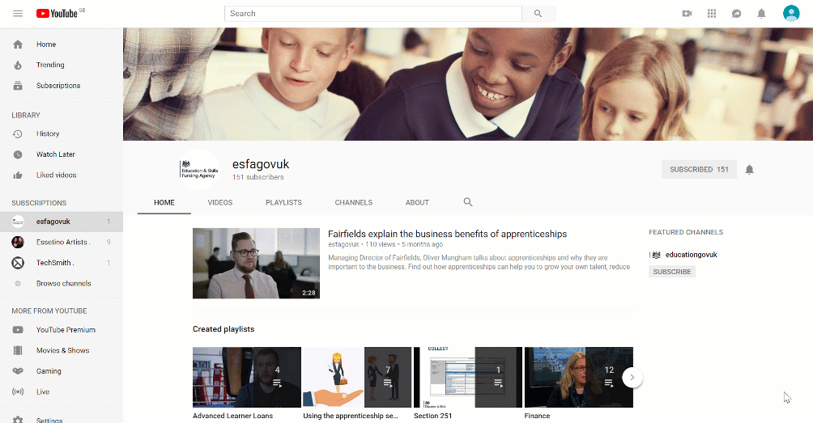
Support Videos
Subscribe to our esfagovuk YouTube Channel.
Watch our “Using the apprenticeship service” playlist
Notes:
There are a number of different places that you an access additional support about the apprenticeship service.
Keep checking out our ESFAGOVUK YouTube channel for the latest apprenticeship service videos – you can find them on our ‘Using the apprenticeship service’ playlist.
We are currently undertaking a review and refresh of all the existing videos to ensure they are as up to date as possible. In addition we will be making it easier for you to search for certain parts of the recording with a new contents page for each video.
We plan to add more apprenticeship service videos in the future to support new releases, and we will also publish recordings of our webinars, including today’s…
…so please make sure you subscribe to our channel, and click the Bell Icon to get alerts when new content is uploaded.

Slide 6
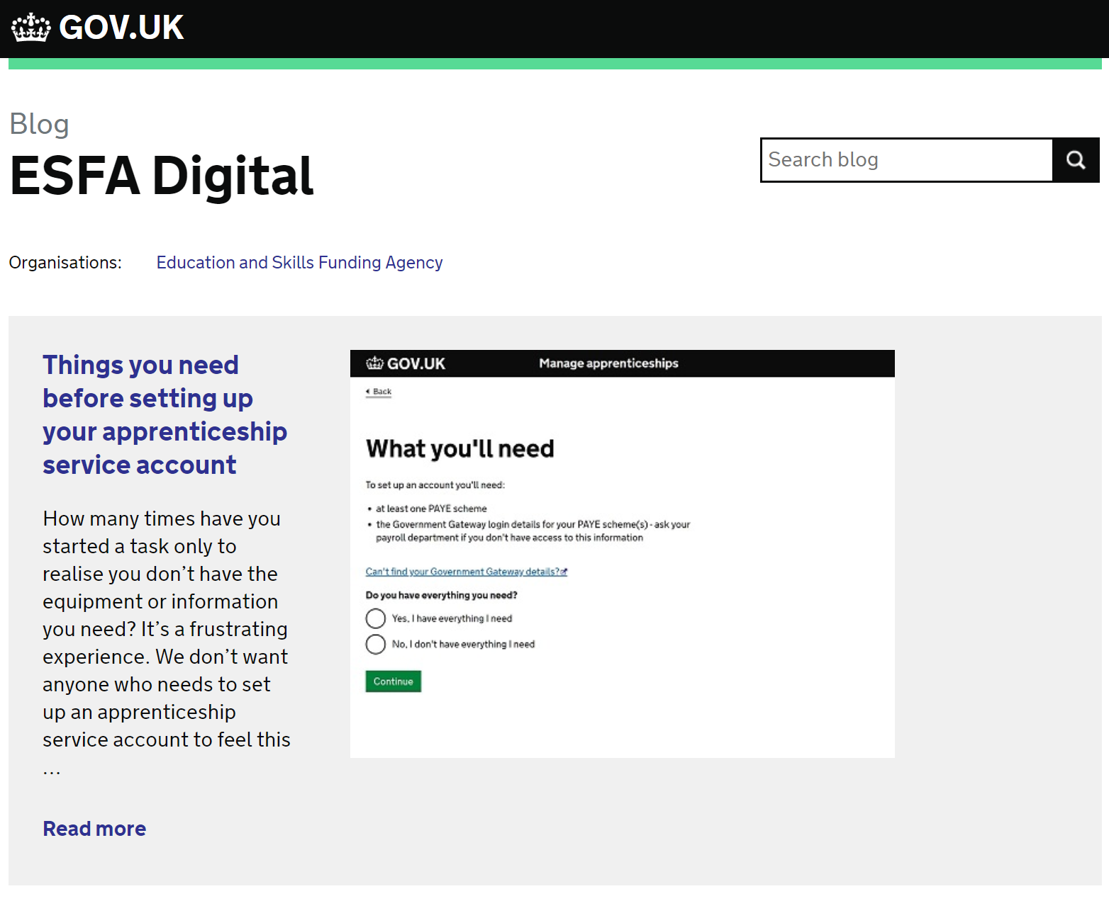
Further Support
To register for our future webinar programme:
www.gotostage.com/channel/apprenticeshipservicewebinars
Set up web alerts on GOV.UK for our ESFA Digital Blog:
https://sfadigital.blog.gov.uk
Newsletters:
Update (for providers weekly)
Inform (for providers monthly)
Business Update (for employers monthly)
Queries about the apprenticeship service:
T: 08000 150 600
W: help.apprenticeships.education.gov.uk
E: helpdesk@manage-apprenticeships.service.gov.uk
(8am – 8pm everyday)
Notes:
To register for our future webinars you should follow the link:
www dot gotostage, dot com, forward slash, channel, forward slash, apprenticeship service webinars
Other ways to stay up to date include our ESFA Digital Blog.
You can find them at sfadigital, dot blog, dot gov, dot uk
We publish a new blog around once a fortnight and they cover a range of subjects including things like
Withdrawal of Frameworks
New developments in the service….
We will also put articles for employers and providers into our monthly Business Update newsletter.
If your employers have any specific queries about the apprenticeship service, they can use the new Self-Service Support Tool, on
help dot apprenticeships, dot education, dot gov, dot uk, or
they can contact the apprenticeship helpline on 0 8000 150 6000 to speak to one of our advisers., or
email helpdesk @, manage dash apprenticeships, dot service, dot gov, dot uk.
The contact details are on the slide.
And If you don’t already, then I would also suggest that you follow us on twitter @ESFAdigital
Thank you…

